Slide 1
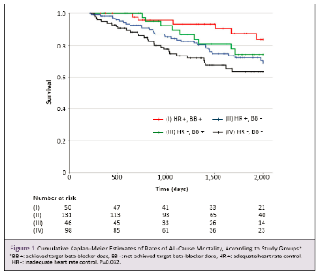
TITLE
author
unit
Content
Content

